Slide 1
Artillery used during World War II
By Michael Keane

Slide 2
World War II
World War II was the bloodiest conflict in history to date and consumed the globe from 1939 to 1945.
World war II was fought mainly in Europe and across the Pacific and eastern Asia, and pitted the Axis powers of Nazi Germany, Fascist Italy, and Japan against the Allied nations of Great Britain, France, China, the United States, and Soviet Union.
While the Axis enjoyed early success, they were gradually beaten back, with both Italy and Germany falling to Allied troops and Japan surrendering after the use of the atomic bomb.

Slide 3
Introduction
I decided to write about the various types of artillery used during World War II because this is something that interests me.

Slide 4
Artillery used during World War II
There was a variety of artillery used during World War II which included:
Weapons
Tanks
Fighter jets
Atomic bombs

Slide 5
Weapons used during World war II
Some of the common infantry weapons of World War 2 included:
A Lugers - an arm-locked pistol
M1 Garand- The first semi-automatic rifle to be used in active military service. The M1 Garand is distinctly remembered the most for its unique “end bloc” clip that made a loud ping sound when the last round is discharged.
M1919 Browning Automatic Rifle - (BAR)Built for the purpose of being used for ‘walking fire,’ a tactic used in WW1. The rifle was used in WW2 as a light machine gun, fired from a bi-pod.
Thompson SMG-There are two notable variations of the Thompson. The first is the SMG used in WW2 and the second is the “Tommy Gun” used during the prohibition era with a forward grip and drum magazine.
STEN-Most notable for its side-mounted magazine and favoured by commandos and resistance fighters for its ease of assembly. Also fondly known for being used as the template for the blaster rifle wielded by Imperial Stormtroopers in Star Wars.
M1 Carbine-The carbine version of the Garand rifle; used mainly as an alternative to an SMG and preferred by paratroopers

Slide 6
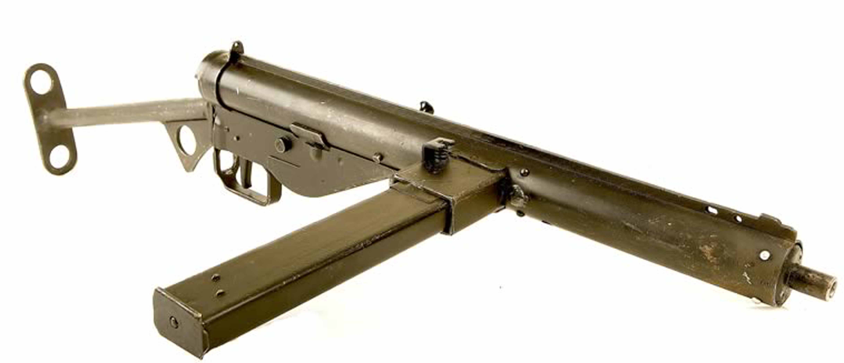
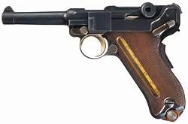
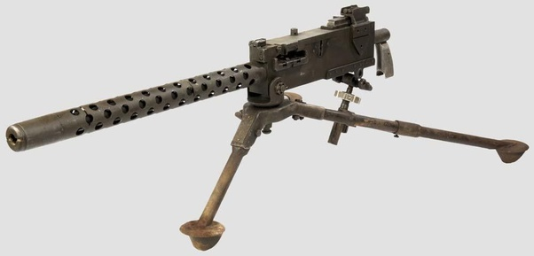
some of the Weapons

Slide 7
tanks used in world war II
World War II tanks started as lightly armed "tankettes" and infantry support vehicles, but quickly gained in power and speed as the need for bigger and better tanks was revealed. Soon, the modern T-34, Panther, and Sherman were ruling the battlefield with bigger cannons, thicker armorer, and most importantly, mass quantities. By the end of the war, monsters like the Soviet IS-2, German Tiger II, and American Pershing would set the stage for the modern main battle tanks still used to this day.
These iconic vehicles captured the imagination of the public and became symbols of the struggle of the Second World War. The T-34 especially proved to be so powerful and hard to beat that it changed the course of the war on the Eastern Front, helping turn a sure defeat into victory. And self-propelled assault guns and tank destroyers based on the designs of the mainstay tanks of the war played vital roles in supporting infantry and hunting enemy tanks.

Slide 8
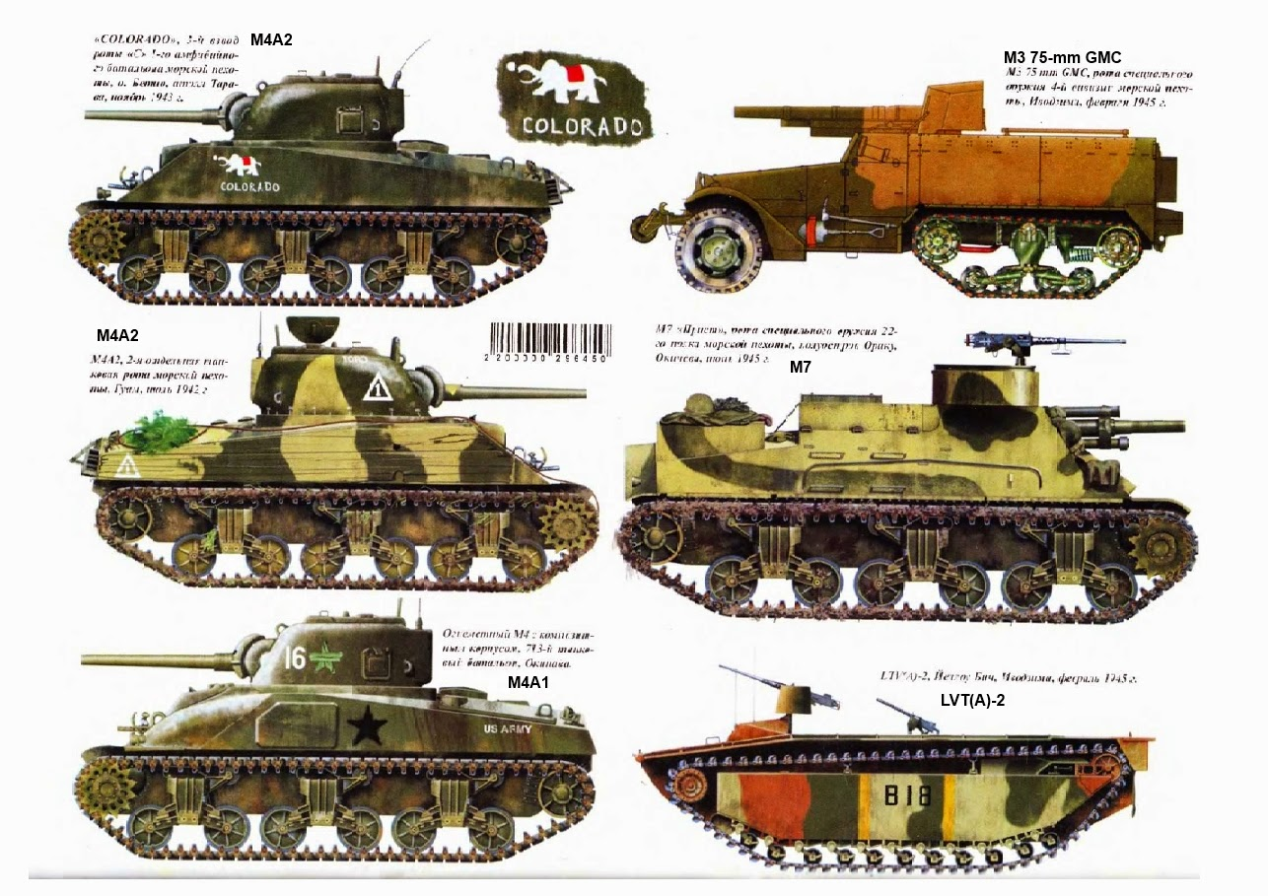
Variety of tanks used

Slide 9
Jet aircrafts
This was the first war in which jet aircraft participated in combat with examples being used on both sides of the conflict during the latter stages of the war. The first successful jet aircraft, the Heinkel He 178, flew only five days before the start of the war, on 1 September 139.
Germany was the only country to use jet-powered bombers operationally during the war.
Germany, the United Kingdom, and the United States all had operational turbojet-powered fighter aircraft which they used during the War.

Slide 10
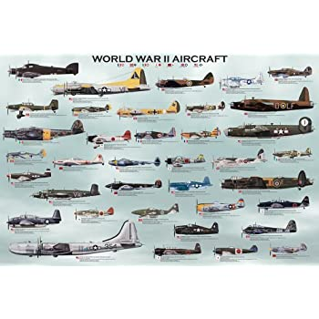
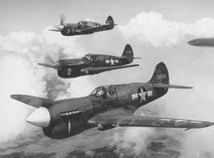
Jet aircrafts

Slide 11
The Atomic bomb
On August 6, 1945, during World War II (1939-45), an American B-29 bomber dropped the world’s first deployed atomic bomb over the Japanese city of Hiroshima.
The explosion wiped out 90 percent of the city and immediately killed 80,000 people; tens of thousands more would later die of radiation exposure.
Three days later, a second B-29 dropped another A-bomb on Nagasaki, killing an estimated 40,000 people

Slide 12
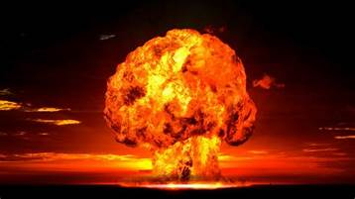
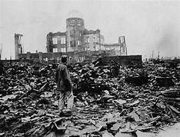
Atomic bomb

Slide 13
conclusion
I learnt World War II was the bloodiest conflict in history to date and consumed the globe from 1939 to 1945.
There was a variety of artillery used by all participating countries which included guns, tanks ,planes and the atomic bomb
I hope there will not a worse war than WWII in my life.

