Slide 1


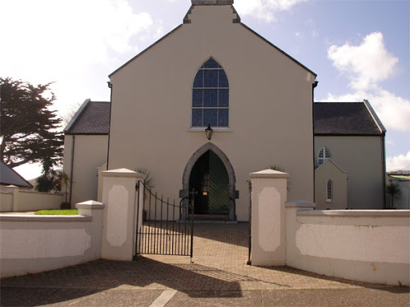
First Holy Communion Day
Saturday 2nd May

Slide 2
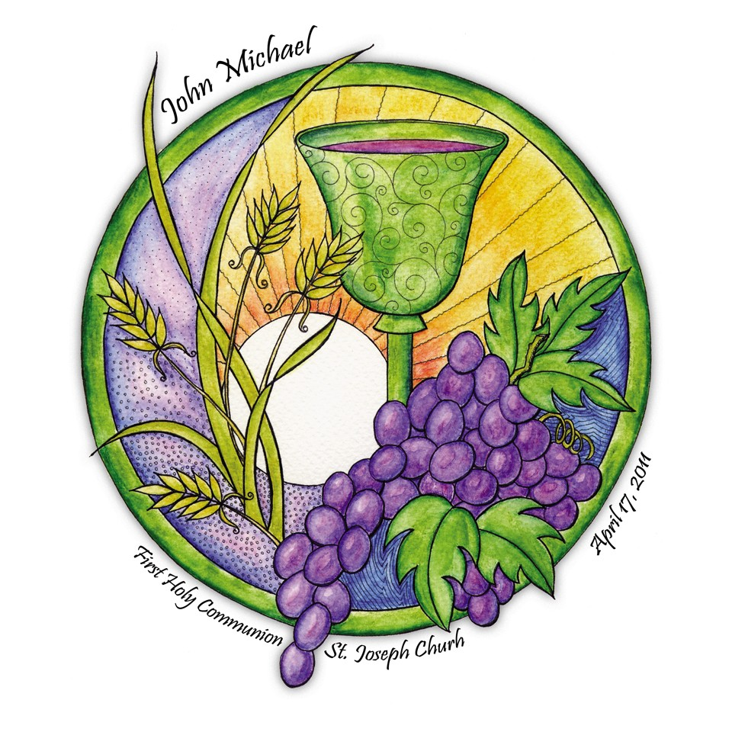

Today was the day ... Rang 2 should be getting all dressed up and ready to make their First Holy Communion in St.Mary’s Church Castlegregory at 11am.

Slide 3
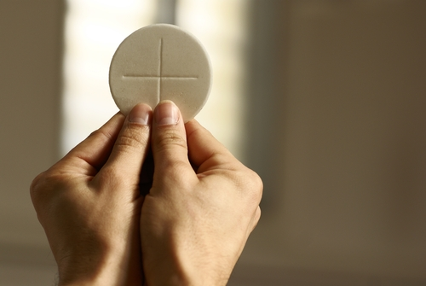
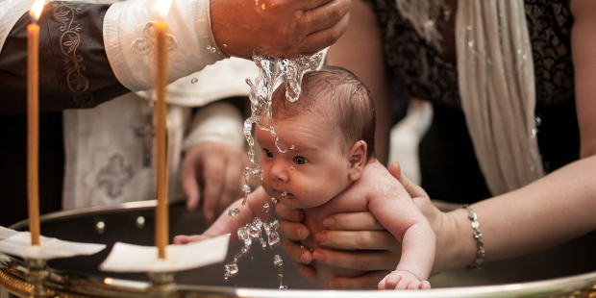
This would be the first time you receive the Body of Christ in Church. This is a very, very special moment, one that you will never forget. Like when you were baptised as a child into God’s family. I know you have to wait a little longer for this special moment to happen, but IT WILL HAPPEN and it will be all the more special when it does.

Slide 4
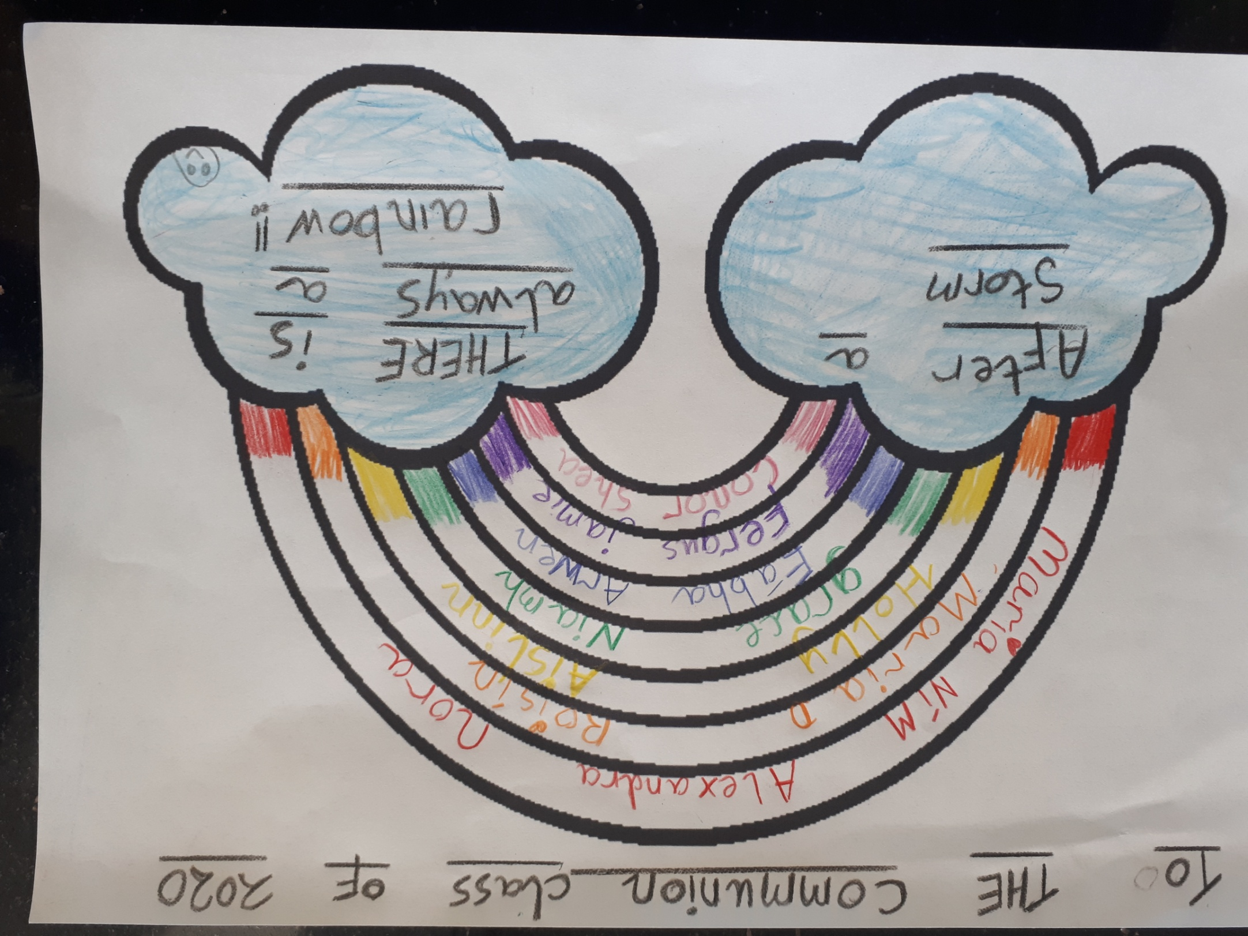

Slide 5
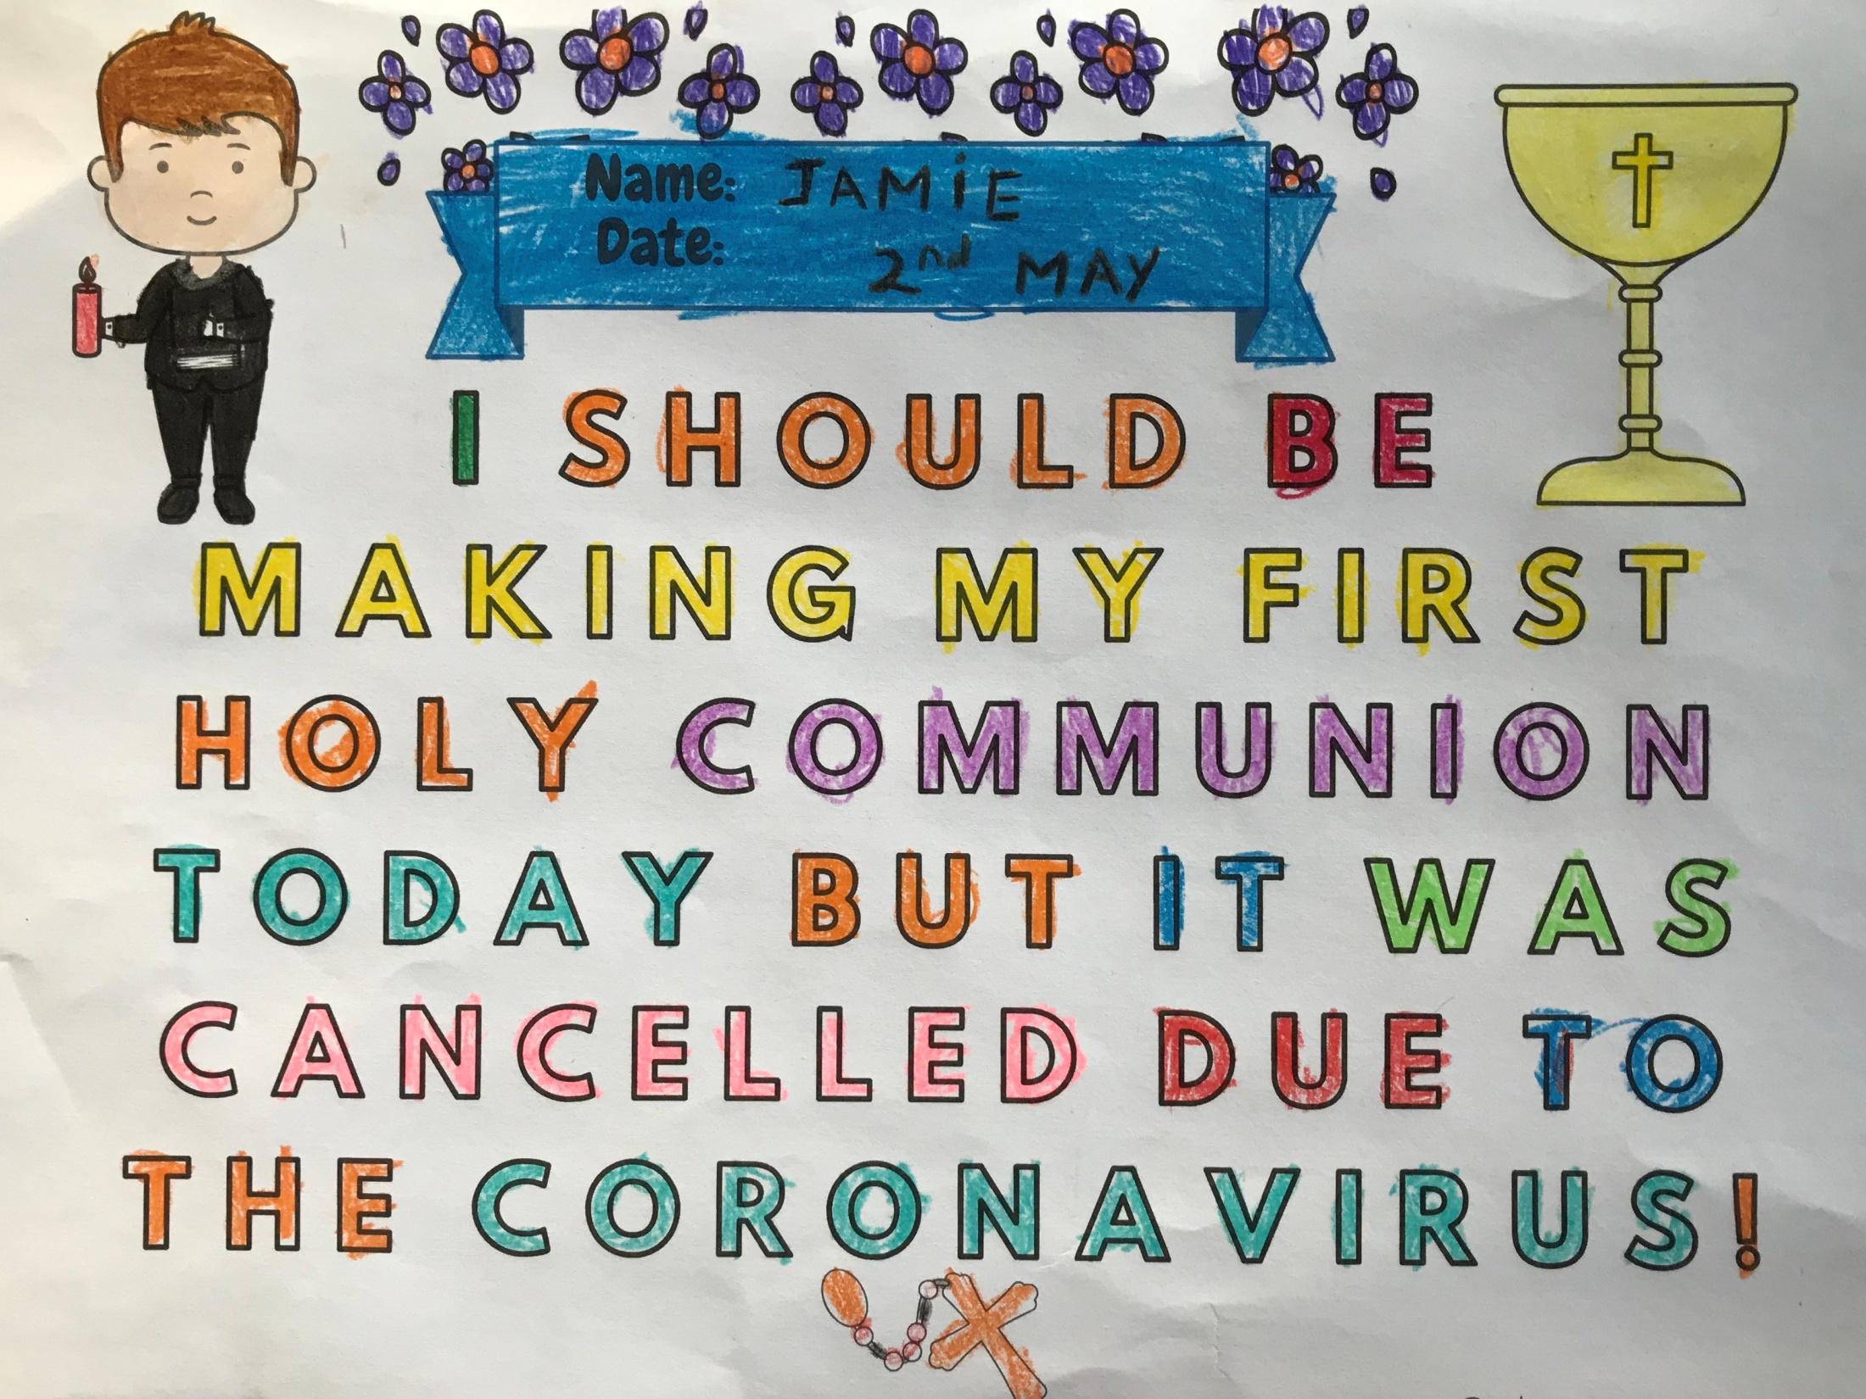

Slide 6
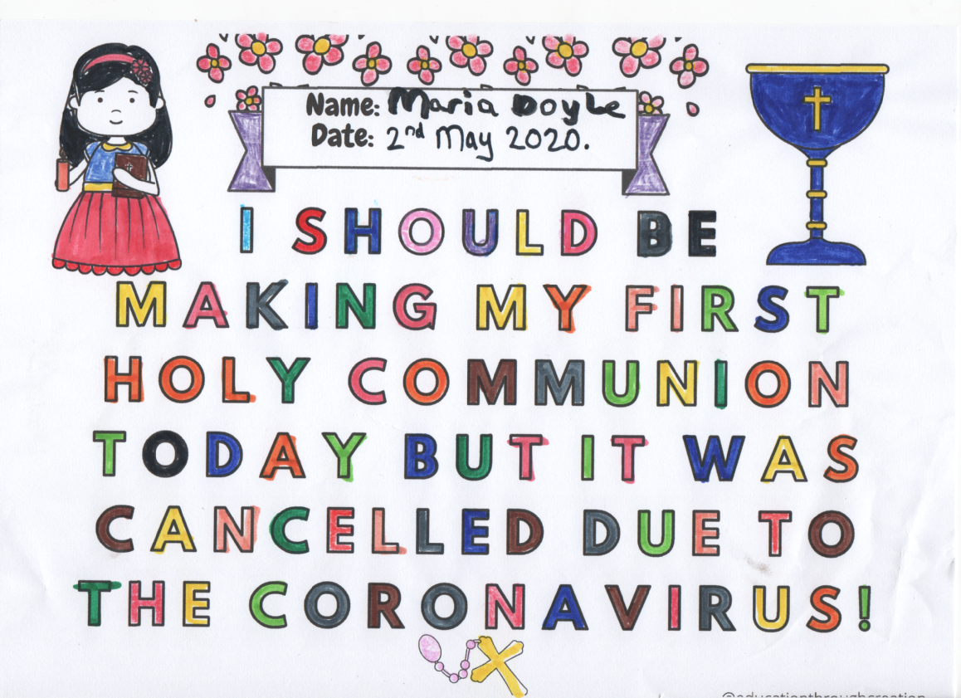

Slide 7
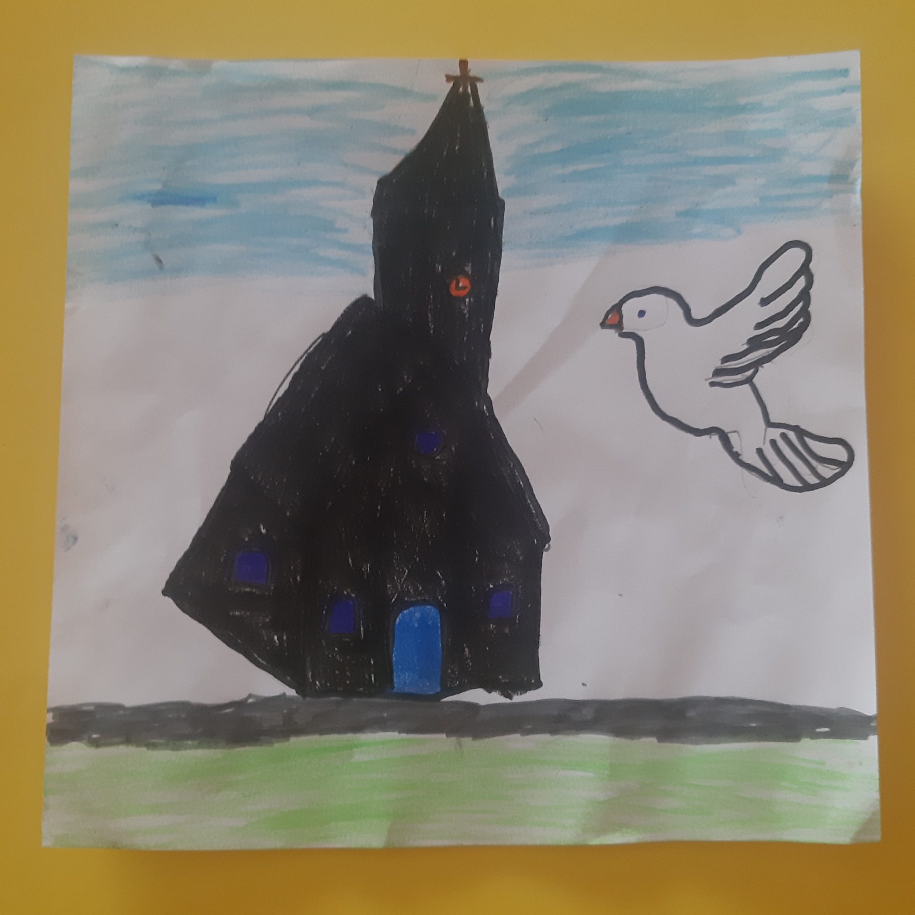
By Fergus Fitzgerald

Slide 8
What does your First Holy Communion mean to you? ...

Slide 9
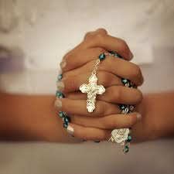
MY FIRST HOLY COMMUNION DAY
BY ROISIN O DRISCOLL
My First Holy Communion was supposed to be this Saturday. But it was cancelled because of the Corona Virus.
On the day we would have to go very early to the church to get a seat because there would be so many people there.
I was supposed to do the first reading at my Communion Mass.
After the Communion mass, Maria my first cousin and I were going to have a big party with balloons and ice cream.
The next day we were going to go on holidays with the Doyle’s to Bella Italia in Italy.
I wish the Corona Virus was not here!!!!!!!!!!

Slide 10
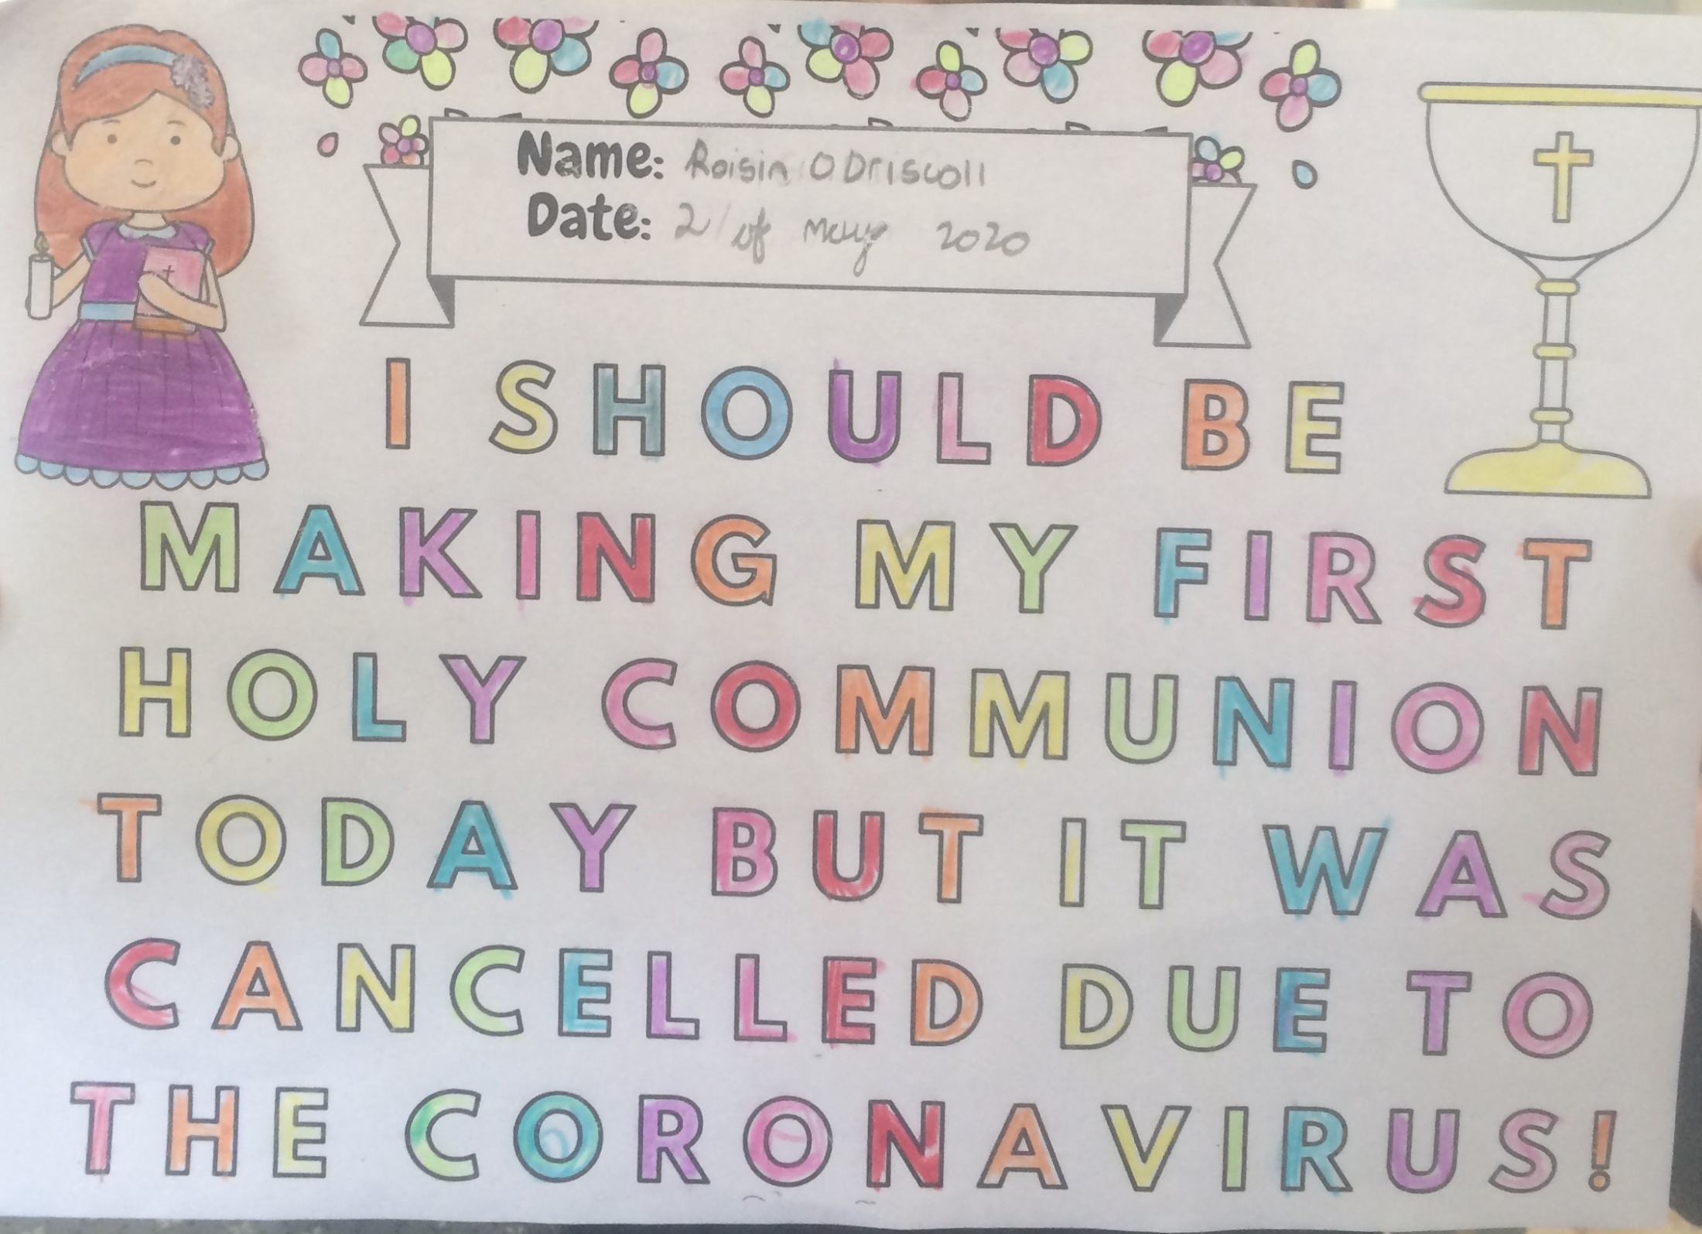

Slide 11
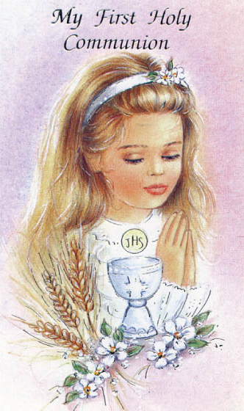
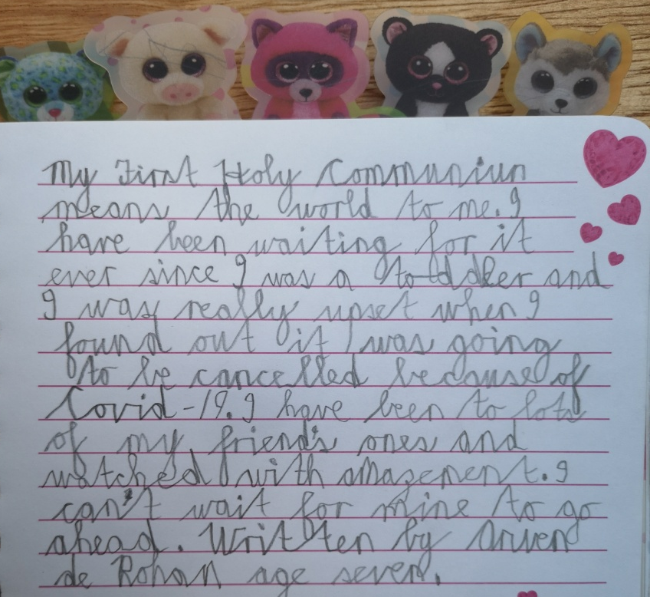
Arwen ...
My First Holy Communion means the world to me. I have been waiting for it ever since I was a toddler and I was really upset when I found out it was going to be cancelled because of Covid-19. I have been to lots of my friends ones and watched with amazement. I can’t wait for mine to go ahead.

Slide 12
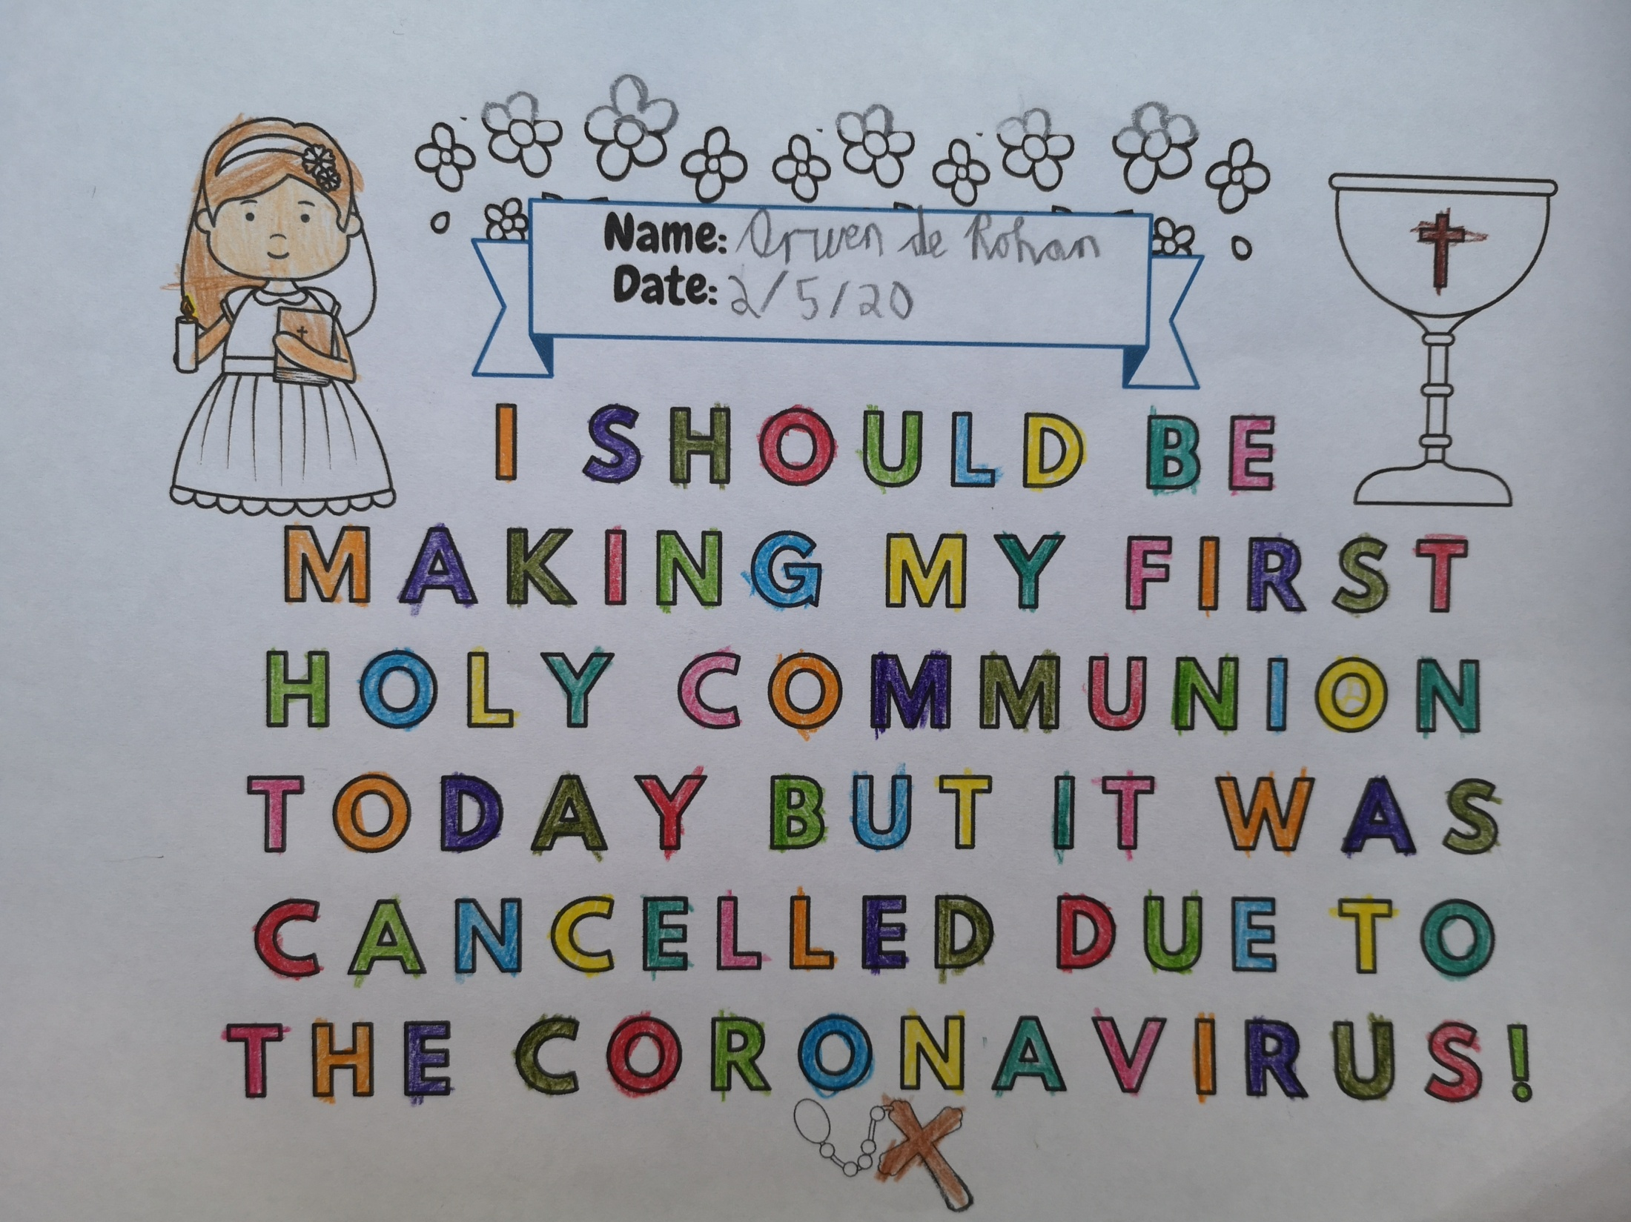

Slide 13
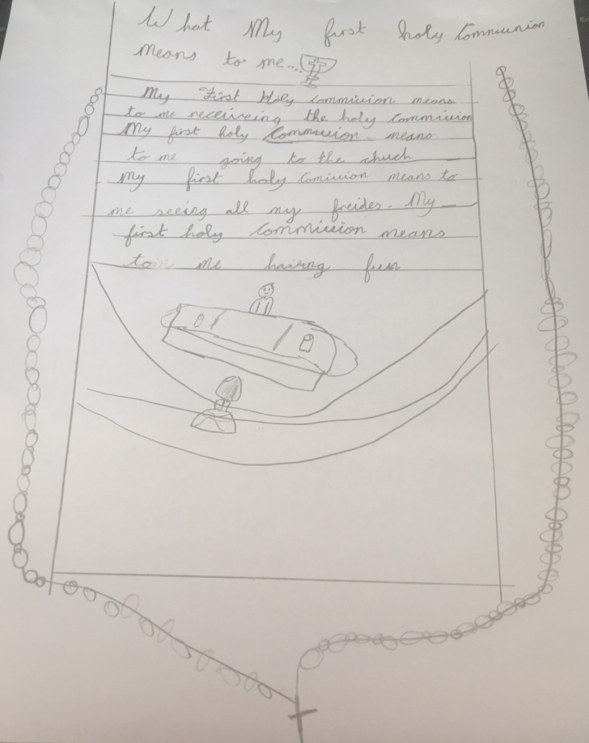
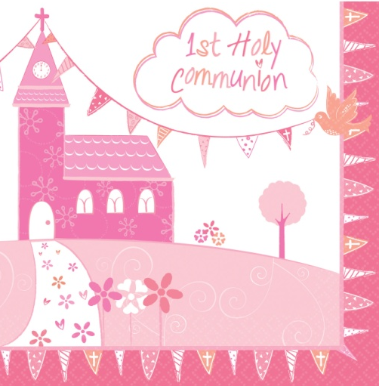
Éabha ...
My First Holy Communion means to me receiving the Holy Communion.
My First Holy Communion means to me going to the church.
My First Holy Communion means to me seeing all my friends.
My First Holy Communion means to me having fun.

Slide 14
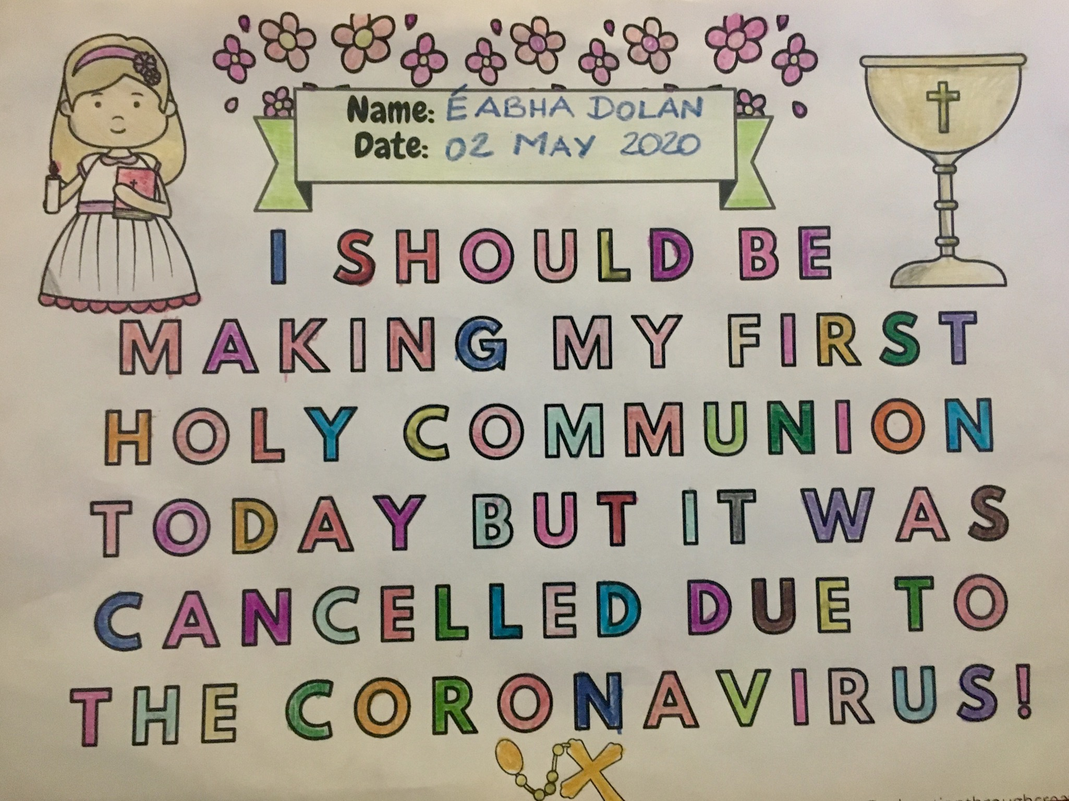

Slide 15
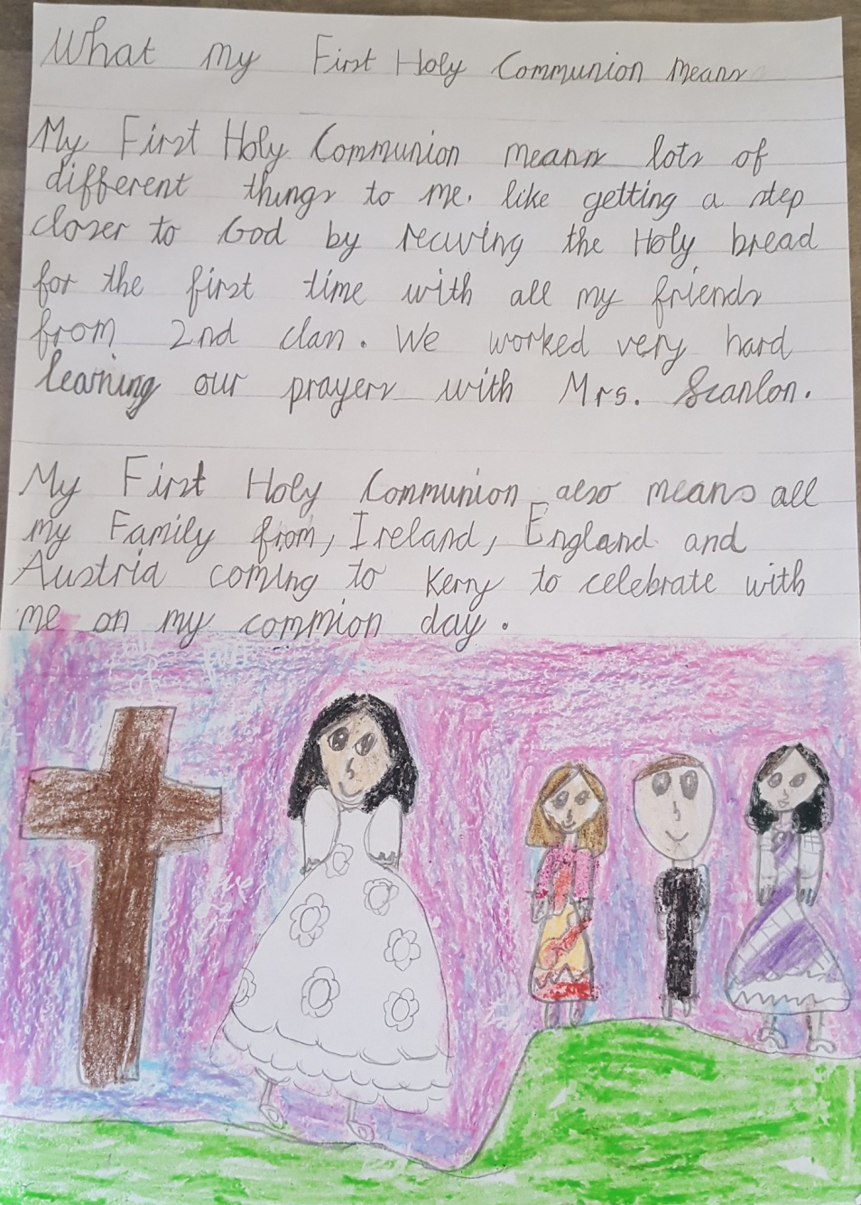
Grace ...
My First Holy Communion means lots of different things to me. Like getting closer to God by receiving the Holy bread for the first time with all my friends from 2nd Class. We worked very hard learning our prayers with Mrs Scanlon.
My First Holy Communion also means all my family from Ireland, England and Austria coming to Kerry to celebrate with me on my Communion Day.

Slide 16
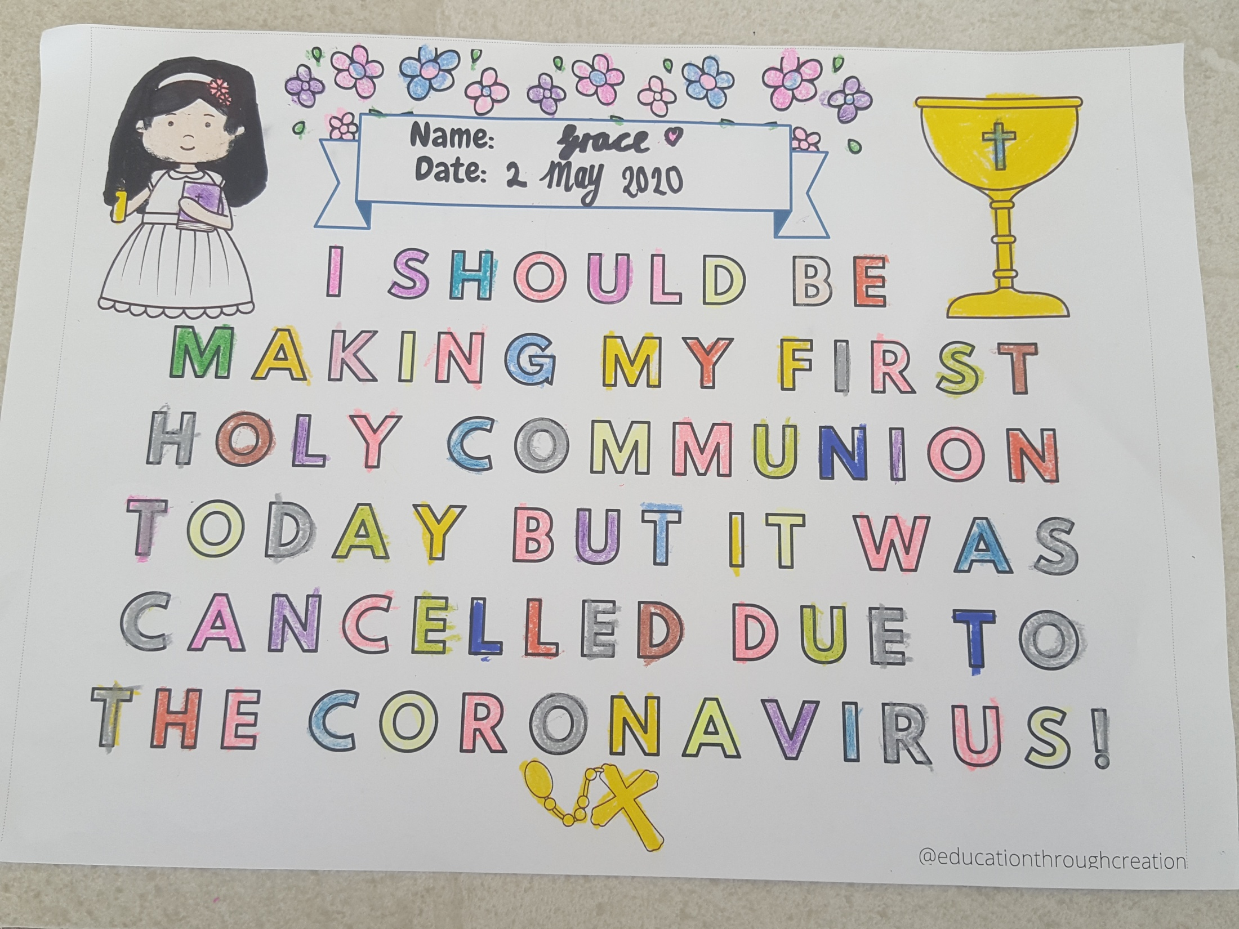

Slide 17
How will you celebrate your First Holy Communion Day when it happens? ....

Slide 18
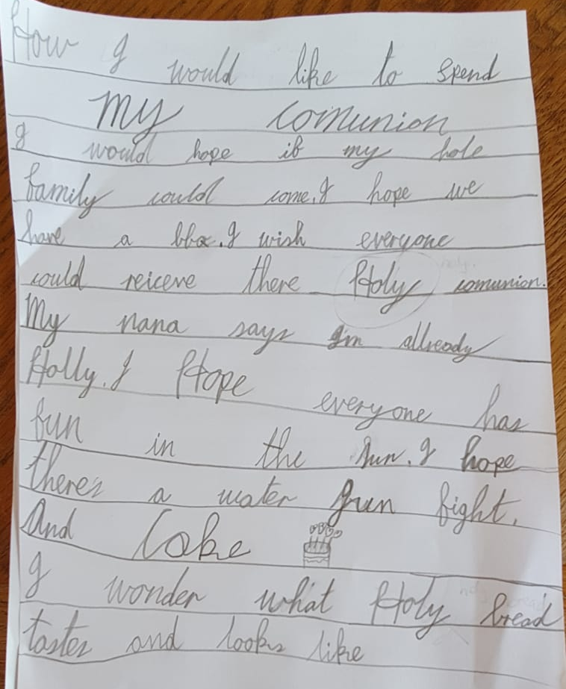

Aislinn ...
“I would hope if my whole family could come. I hope we have a BBQ. I wish everyone could receive their Holy Communion. My Nana says I’m already holy. I hope everyone has fun in the sun. I hope there’s a water gun fight and cake. I wonder what Holy bread tastes and looks like.”

Slide 19
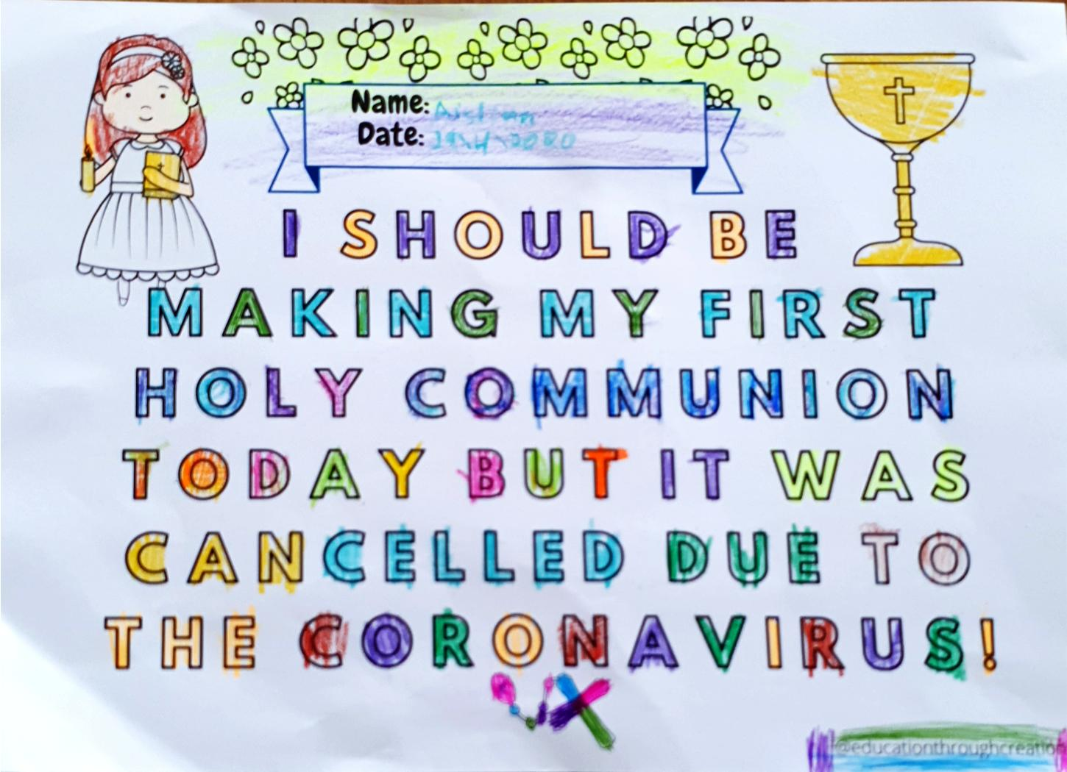

Slide 20
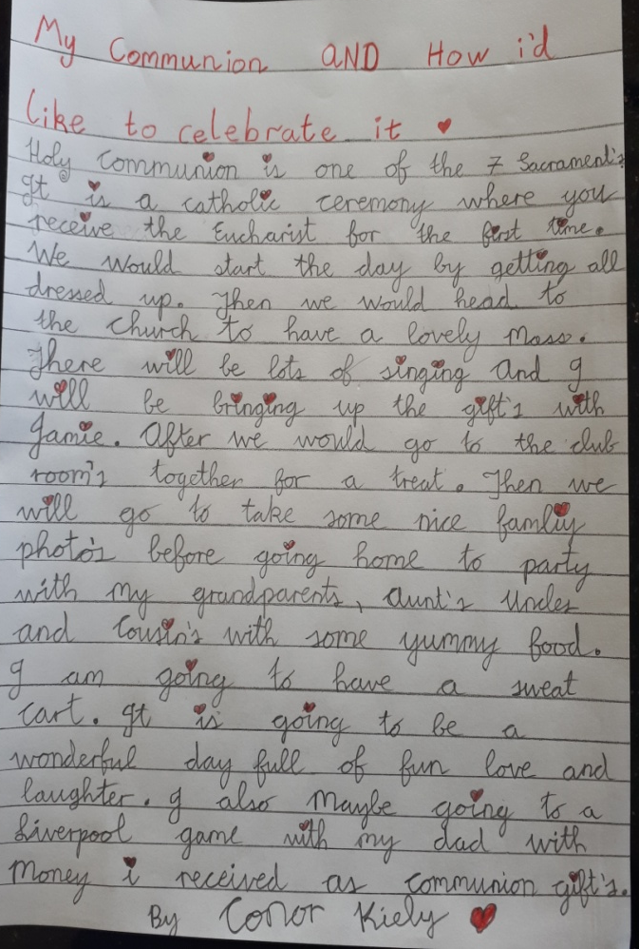
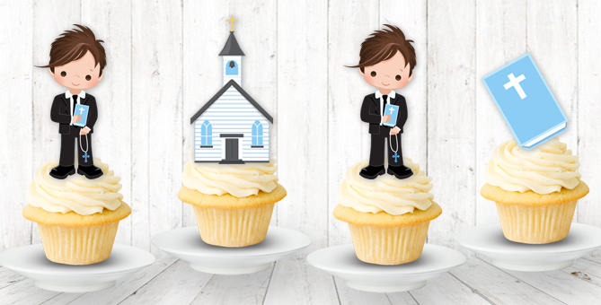
Conor ...
Holy Communion is one of the seven sacraments. It is a Catholic ceremony where you receive the Eucharist for the first time. We would start the day by getting all dressed up. Then we would head to the church to have a lovely mass. There will be lots of singing and I will be bringing up the gifts with Jamie. After, we would go to the Club Rooms together for a treat. Then we will go take some nice family photos before going home to party with my Grandparents, aunts, uncles and cousins with some yummy food. I am going to have a sweet cart. It is going to be a wonderful day full of fun, love and laughter. I am also maybe going to a Liverpool game with my Dad with money I received as communion gifts.

Slide 21
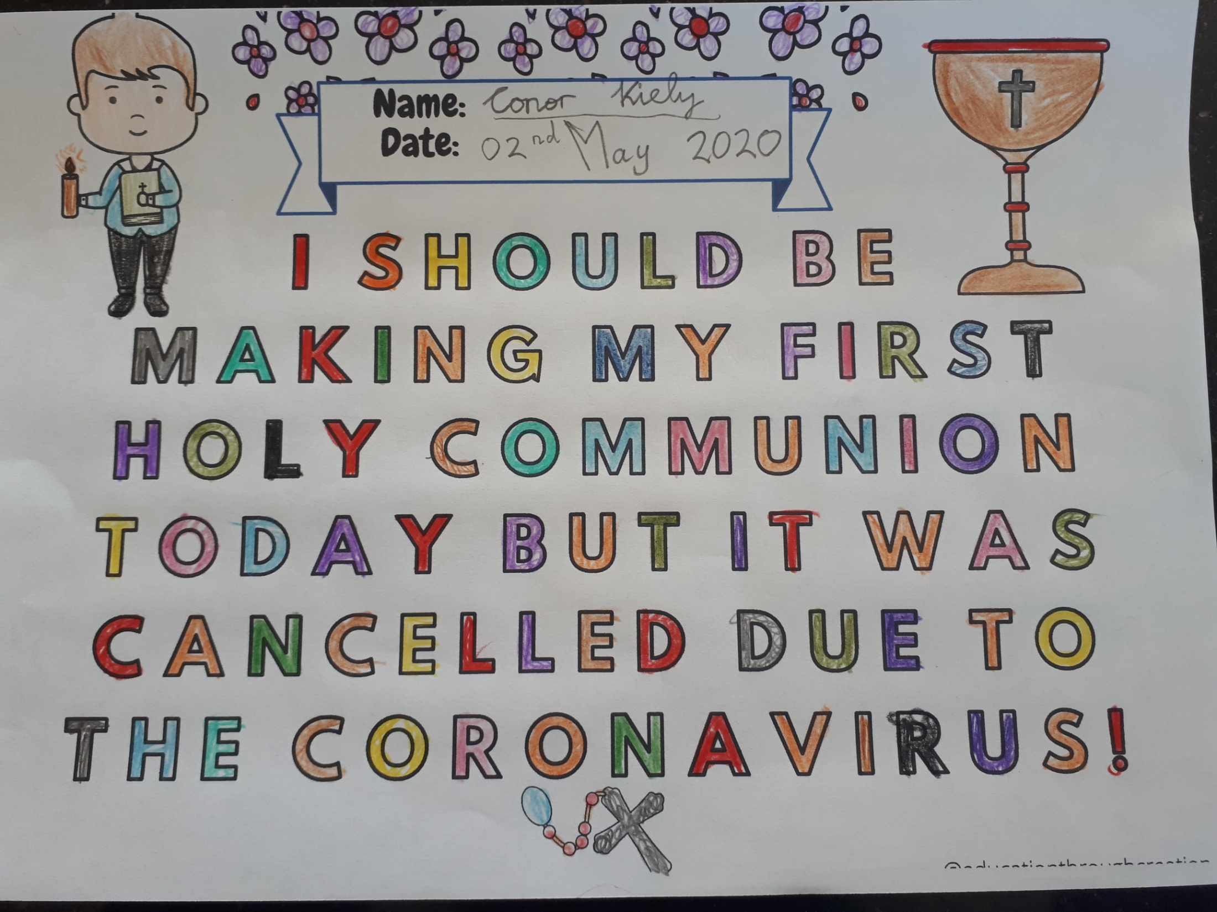

Slide 22
Alexandra
Aislinn
Arwen
Conor
Éabha
Fergus
Hollie
Grace
Jamie
Maria D
Maria N.M
Nora
Shea
Niamh
Róisin

Slide 23


I hope you all have a wonderful day today and please remember .... Good things come to those who wait ... and good it will be!

